Slide 1
Angry Prims Final Presentation
Christian William
Francis Sabado
Aaron Mahmoud
University of Arkansas
23 Apr 2012
Notes:
This template can be used as a starter file to give updates for project milestones.
Sections
Right-click on a slide to add sections. Sections can help to organize your slides or facilitate collaboration between multiple authors.
Notes
Use the Notes section for delivery notes or to provide additional details for the audience. View these notes in Presentation View during your presentation.
Keep in mind the font size (important for accessibility, visibility, videotaping, and online production)
Coordinated colors
Pay particular attention to the graphs, charts, and text boxes.
Consider that attendees will print in black and white or grayscale. Run a test print to make sure your colors work when printed in pure black and white and grayscale.
Graphics, tables, and graphs
Keep it simple: If possible, use consistent, non-distracting styles and colors.
Label all graphs and tables.

Slide 2
Problem
Limited audience for current Kinect titles
Bridge games between full body motion and traditional controller or keyboard mouse
Kinect outside of the Xbox environment
Limited Kinect games for virtual world environment
Limitations of the Second Life as a game engine driven environment
Games playing to the strengths of Second Life, existing objects/methods and independent of client

Slide 3
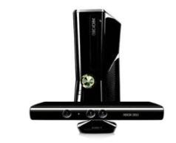
Project Objective
Kinect enabled games in a open world simulated environment.
Develop a game where the goal is to model a real world item using Kinect detected gestures/speech.
Develop a 3D version of AngryBirds using SL as the game engine and Kinect as the control.
Kinect enabled web application?
Notes:
What is the project about?
Define the goal of this project
Is it similar to projects in the past or is it a new effort?
Define the scope of this project
Is it an independent project or is it related to other projects?
* Note that this slide is not necessary for weekly status meetings

Slide 4
Approach
Modeling and Angry Prims
Second Life
Kinect Client, Speech and Gestures
SQL Database / Game object memory
PHP Server (Turing)
Game
Engine
Notes:
What are the dependencies that affect the timeline, cost, and output of this project?

Slide 5
Current Status
Progress that has been made:
Communication between Kinect and Second Life
Rudimentary gesture events written with corresponding actions in Second Life
Model Match game to test feasibility with lessons learned
Developed the game “Maps”
Developed complex gestures
Feasibility of moving entire application to sever
Notes:
* If any of these issues caused a schedule delay or need to be discussed further, include details in next slide.

Slide 6

Assignments
Christian Williams
Design and Network Comms., Map Design
Francis Sabado
HUD Design, Projectile and Cannon, Map Design
Aaron Mahmoud
Gestures and voice control, Map Design

Slide 7
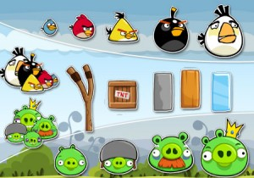
Angry Prims Game
Projectile:
Angry Birds
Slingshot:
Smart object that receives messages from the server.
Obstacles
Targets:
Pigs

Slide 8
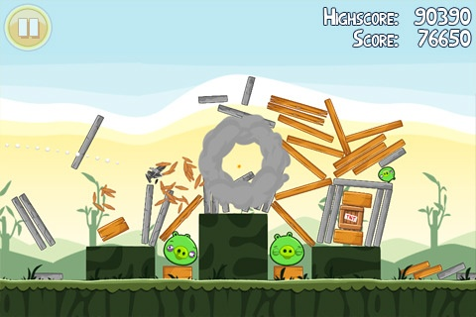
Trajectory, Physics, Collision
Physics
Collision Detection
Trajectory

Slide 9
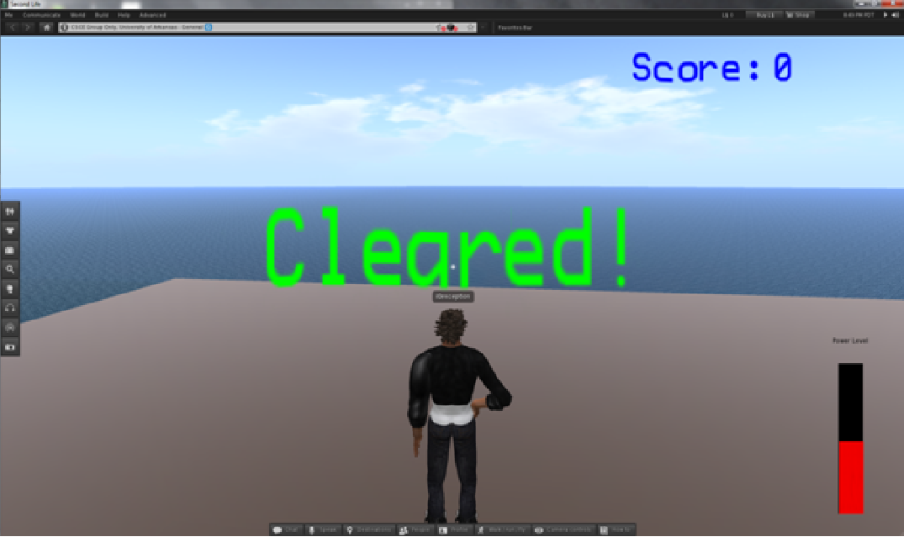
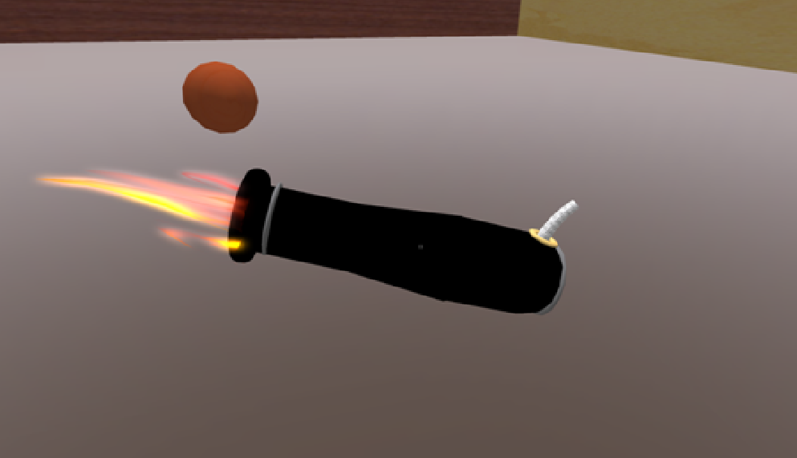
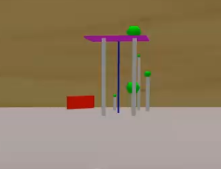
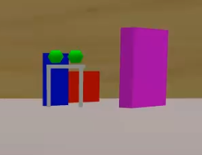
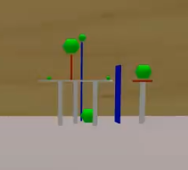
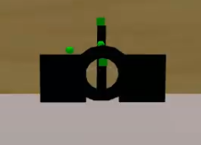
Development Screenshots
HUD Design
Cannon and Bullets
Dynamic Map Creation

Slide 10
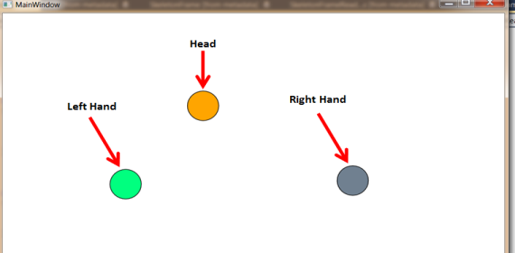
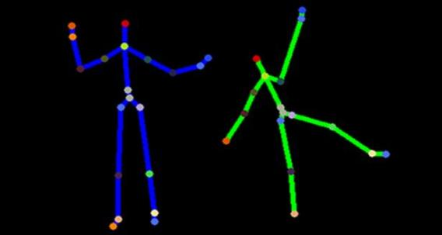
Gesture Tracking
Capturing specific gestures.
Capturing hand and finger movement .
Making fluid movement transition from the Kinect to Second Life
Using the gestures from Kinect with the Objects in Second Life

Slide 11
Speech Recognition
Microsoft Speech Platform (SDK)
Event Handlers track speech and test against given library
Make the given command transition into Second Life.

Slide 12
Video Demo!

Slide 13
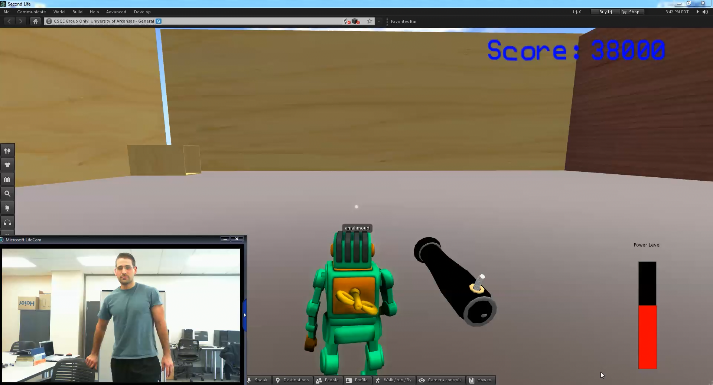

Slide 14
Questions?

